Slide 1
Light Stages

Slide 2
** face caputure에 관련된 내용 위주로.
Light Stage 1: Acquiring the Reflectance Field of the Human Face
Image-Based Relighting
Reflectance Function을 사용
To obtain geometry, a structured light video projector was added to the system
Specular / Diffuse Separation
specular surface reflection and diffuse subsurface scattering.
Light Stage 2: Faster Capture and Facial Animation
Light Stage 2 made recording the reflectance of a face faster by including a set of thirty strobe-lights on a semicircular arm which rotated around the actor in just eight seconds.

Slide 3
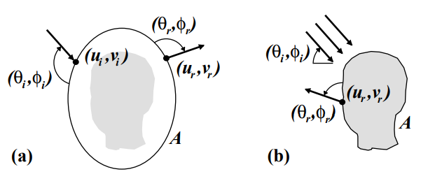


Acquiring the Reflectance Field of a Human Face (Paul Debevec)
Reflectance Field (Reflectance Function)
Re-illuminating

Slide 4
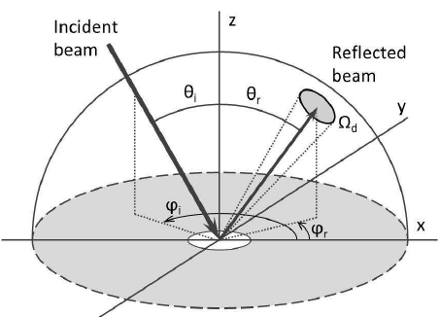
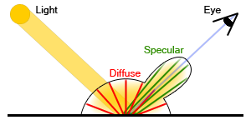
BRDF
"Bidirectional Reflectance Distribution Function" 의 머리글자입니다. 우리 말로는 "양방향 반사율 분포 함수"입니다. 이 BRDF 는 Diffuse BRDF 와 Specular BRDF 로 나뉩니다.

Slide 5
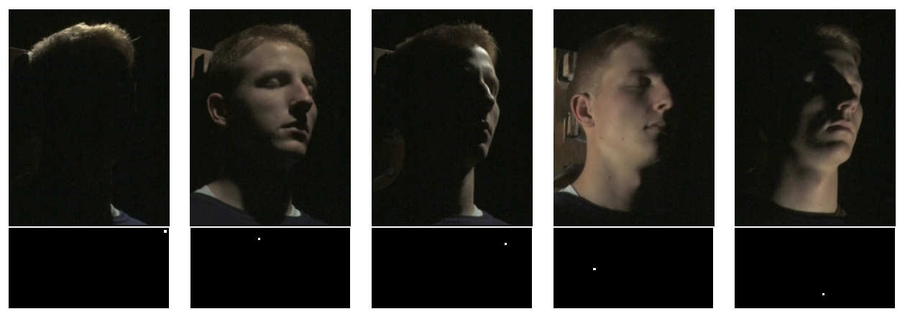
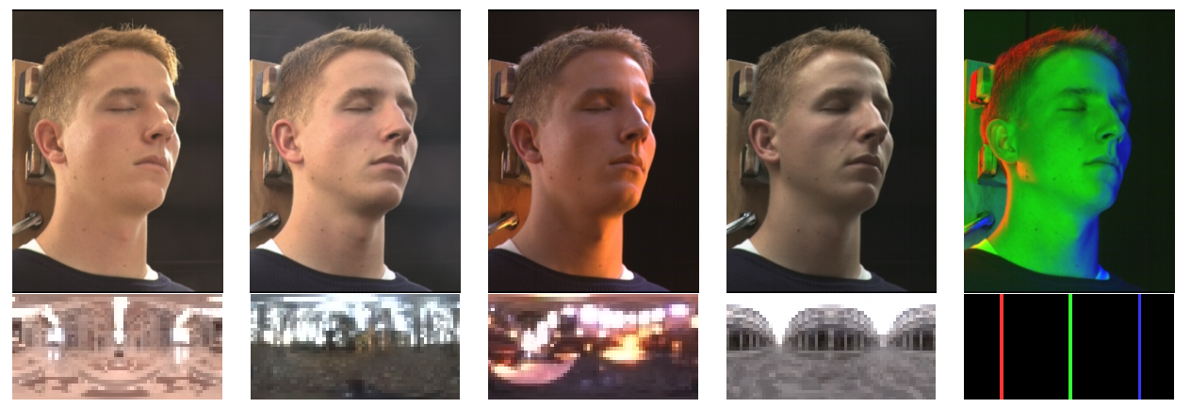

Slide 6
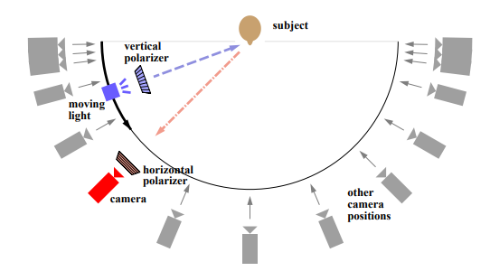
Skin Reflectance
diffuse and specular components
Polarization 이용하여 Separation (Fresnel Equation)
Specular는 Polarized, Diffuse는 unpolarized
diffuse reflectance function & specular reflectance function
Surface Normal & Albedo
Viewpoint Change (Calibration is pre-computed)
Rendering 가능
Face geometry recovered using structured lighting

Slide 7
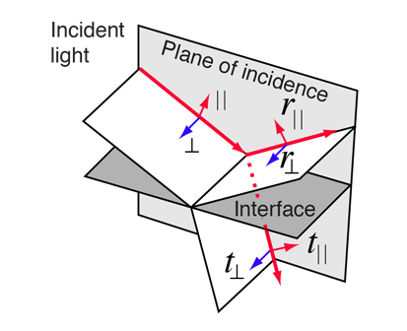
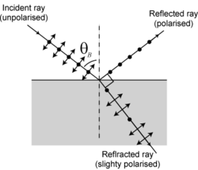

Polarization-Based Analysis of Reflected Light
전기장의 방향 :
빨간색 : TE (수직 편광)
파란색 : TM(수평 편광)
Fresnel Equation
Frenel Equation
Brewster's angle
determine what portion of observed light arises from diffuse reflection and what portion from specular reflection.
Diffuse and specular reflection components differ in that specular reflection alters polarization in a deterministic manner in accordance with the Fresnel equations, while diffuse reflection produces outgoing light which is generally close to unpolarized.
Polarize the incident illumination
Separation using Linearity

Slide 8
Light Stage 3: Lighting Reproduction
Light Stage 5: Performance Relighting
With the advent of bright white LEDs, it became possible to record an actor’s reflectance dynamically using time-multiplexed illumination and high-speed video, allowing their performance to be re-lit in postproduction
Light Stage 6: Re-lighting the Whole Body

Slide 9
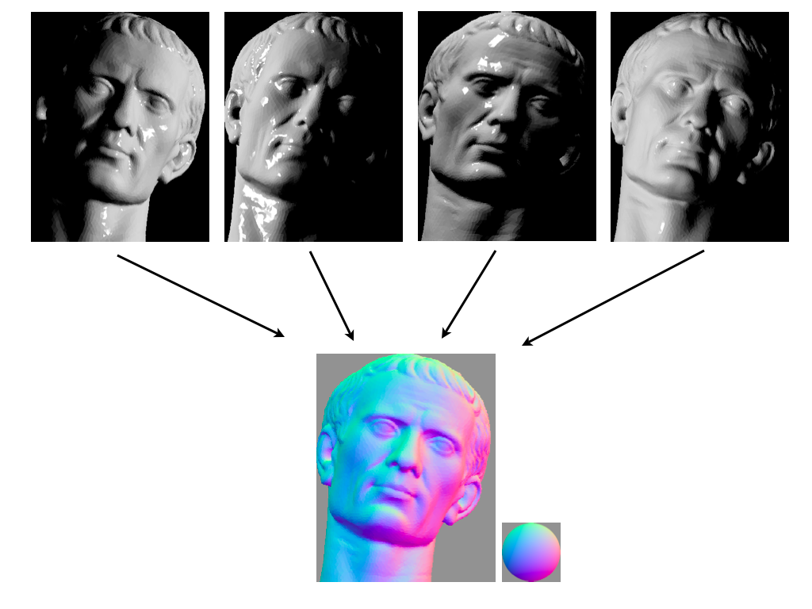
Photometric Stereo
process of determining surface orientation of a Lambertian surface from its appearance under multiple illumination directions using a simple linear system.
Lambertain Reflectance

Slide 10
Spherical Harmonics
digitize facial geometry with sub-millimeter precision :
leveraging the full sphere of LED light sources in Light Stage 5 to create spherical illumination patterns.
Instead of lighting the face one direction at a time, requiring hundreds of photographs to record reflectance functions, key statistics of the reflectance functions would be measured using computational illumination patterns based on the first four spherical harmonics [Ma et al. 2007].
Spherical Harmonics 이용
이것을 이용하면 따로따로 하지 않아도 되는 이유는?
The total energy of a pixel’s reflectance function could be measured simply by lighting the face with spherical light from everywhere, corresponding to the 0th order spherical harmonic. For a diffuse surface, this yields the diffuse color. The centroid of the reflectance of each reflectance function could be measured by lighting the face by gradient patterns derived from the first three 1st order spherical harmonics oriented along the three principal coordinate axes. For a diffuse surface, this yields the surface normal, since a Lambertian reflectance lobe is symmetrically oriented along the normal.

Slide 11
Gradient Illumination Face Scanning
Polarized Spherical Gradient Illumination
전 논문과 다르게 Spherical Lighting을 사용
separate photometric albedo and normal maps for specular (surface) and diffuse (subsurface) reflection by employing polarization of incident lighting.
estimate surface normal maps of an object from either its diffuse or specular reflectance using four spherical gradient illumination patterns
the diffuse and specular normal maps of an object to be measured independently
Scattering material에 대해 Specular normal map이 효과적
limits the acquisition to a single viewpoint providing limited coverage of the scanned subject.

Slide 12
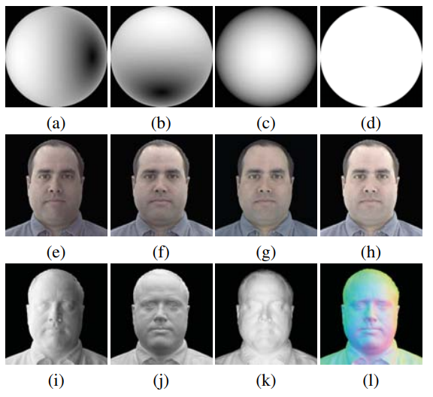
Computing normal from x, y, z lighting using reflectance function
Lambertian Surface Reflection & Specular Surface Reflection.
Near the Brewster angle the reflection is weak, making recovery of true specular reflectance unstable
Linear / Circular polarizers
Surface Geometry
combining a medium-resolution structured light scan with high-resolution surface normals based on the specular reflectance

Slide 13
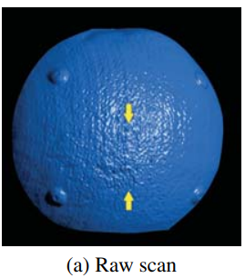
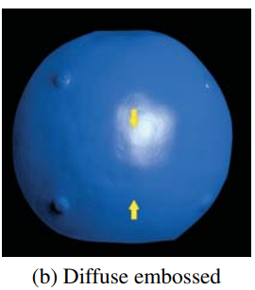
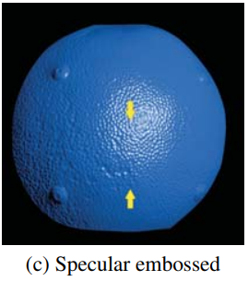

Slide 14
Multiview Capture and Light Stage X
[Ghosh et al. 2011] places a static vertical polarizer on a set of cameras placed around the equator of the light stage, and switches the light stage’s illumination from horizontal to vertical polarization to tune the specular reflection in and out, allowing for simultaneous multiview facial capture.

Slide 15
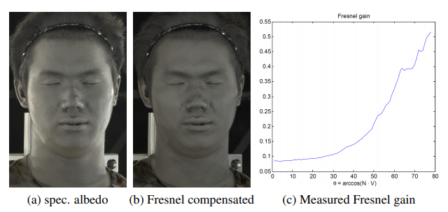
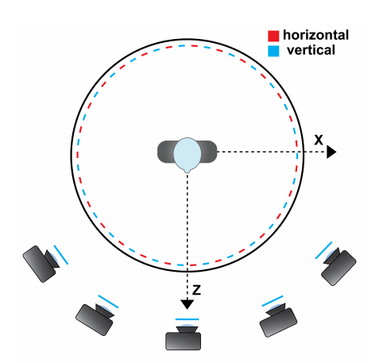
more efficient acquisition of diffuse and specular albedo and normal maps from multiple viewpoints
stereo reconstruction
lat-long polarized lighting patterns
spherical illumination in just two photographs
Specular reflectance를 균일하게 해서 view independent
obtain diffuse and specular albedo and normal maps from multiple viewpoints
compensate for the Fresnel gain to make the specular albedo maps less view-dependent and more suitable for stereo.
Data driven
Stereo Reconstruction : depth map
uses diffuse and specular albedo and normal maps
Cost function minimization (no merging)
Geometry를 얻어내는 과정이 까다로움

Slide 16
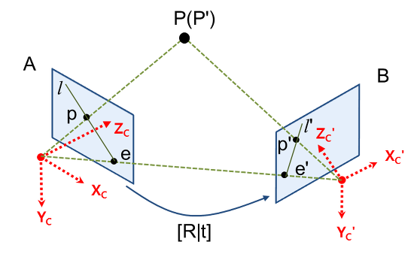
multiview stereo (MVS)
Stereo reconstruction
Photo consistency
Consistency를 바탕으로 (여러 이미지에서 corresponding point) depth를 계산한다. Camera Calibration 정보를 바탕으로 계산 가능하다.
SL 방식에 비해 정확도가 떨어지고, 어렵다.
Surface normal data를 사용해서 minimum cost function 방법으로 접근. 그래도 correspondence는 어떻게 판단할까?
Light Stage에서 rendering을 해내기 위해서는 Base Geometry 정보가 필요하다 (거기에다가 surface normal을 만들어내고, albedo 정보를 만들어내는 것이기 때문)

Slide 17
제언
설계 모델
Structured Light (기존 방법) 보다 좋은 점
기존에는 어떤 방법으로 surface normal, albedo 계산?
Light Stage에서는 정확히 albedo 어떻게 계산?
SL을 같이 사용할 수 있는 방안
필요성 (장점) / 단점

